Slide 1


FloWell - Team 4

Slide 2

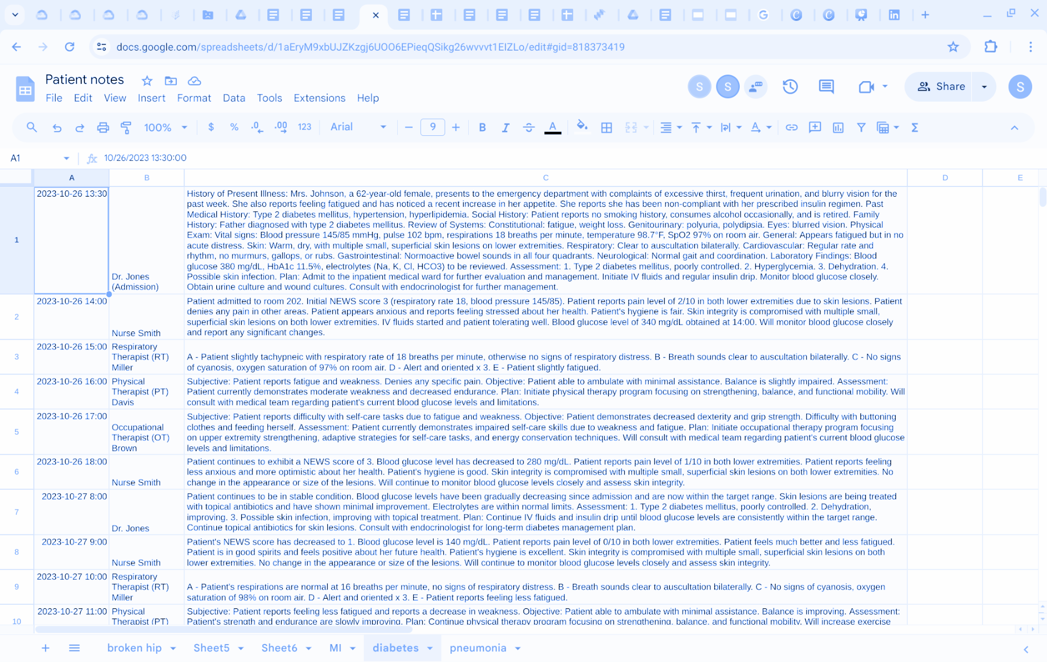
The problem:
Inpatient Electronic Health Records are difficult to navigate and make understanding a patient’s journey time-consuming.
75% of clinicians report that reading through long & complex notes increases stress ⁽¹⁾
More time spent on EPRs increased fatigue and made clinicians less efficient in patient care. ⁽²⁾
75% of clinicians report that long EPR notes increase stress
Poor communication is one of the biggest risks for inpatient care. ⁽³⁾
Only 59.9% of patients can state their diagnosis and management correctly after discharge.⁽⁴⁾
Synthetic patient notes created using Vertex API

Slide 3

Solution
What did you map out as the solution?
What do you plan to do?
What will you deliver?
Navigational tools and summarisation of notes improved quality of care, reduced clinical burden reduced and clinician stress. ⁽⁵⁾
Using StreamLit and Gemini API, create a dynamic timeline with summaries of the patient journey for different audiences.
A demo web app based on a set of medical notes for a 17-day stay in hospital, with summaries for clinician and patient.
FloWell

Slide 4
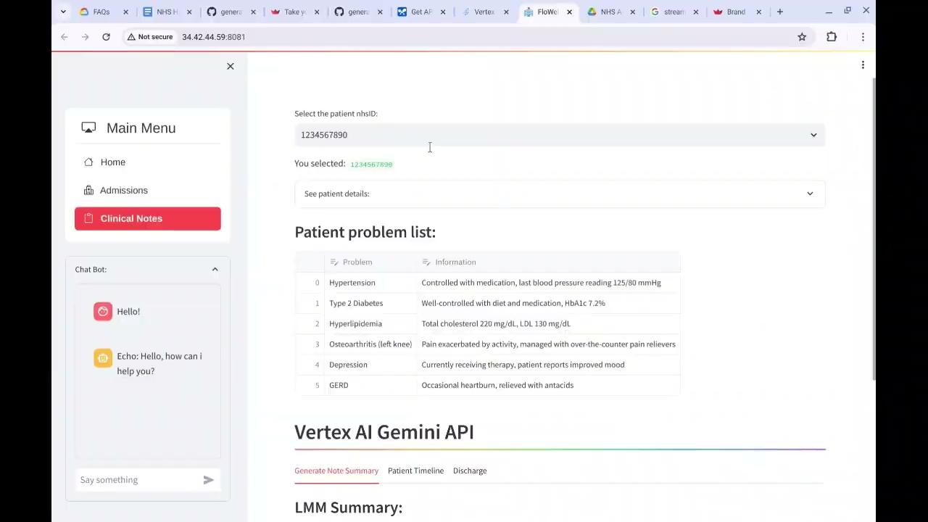

Slide 5
References
https://jamanetwork.com/journals/jamanetworkopen/article-abstract/2748054
https://jamanetwork.com/journals/jamanetworkopen/article-abstract/2766836
https://www.england.nhs.uk/wp-content/uploads/2022/03/spoken-communication-and-patient-safety-in-the-nhs-full-report.pdf
https://www.ncbi.nlm.nih.gov/pmc/articles/PMC4419897/
https://www.thieme-connect.com/products/ejournals/html/10.4338/ACI-2012-05-RA-0017#N10CC5

Slide 6







Thank you!
image
image
image
Wunmi Oluokun
Emily Fenby-Taylor
Tobi Alli-Balogun
Khizer Iqbal
image
image
image
Kristian
Litsis
John
Kideys
Hae Seung Chung

